Slide 1
MULTIPLAYER BINGO GAME
Chinmayi C. R. (181IT113)
Meghna Kashyap (181IT127)
K Keerthana (181IT221)
Team No. 12

Slide 2
INTRODUCTION
This project is a representation of bingo game using a server with multiple clients.
The concept of socket programming is implemented using C++.
Our implementation of the BINGO game in C++ is a client-server application, and as such, is comprised of two C++ programs that run in separate terminals. The server is called the Game, and the client is called the Player.

Slide 3
LITERATURE SURVEY
SI no. | Paper Title and Authors | Work Done | Advantages | Disadvantages
1 | UDP Based Chat Application Akshith Malhotra Vaibhav Sharma Prateek Gandhi Neetesh Purohit | Implementation of socket programming using Java which includes features like peer to peer communication, multicasting and file sharing. | UDP supports multicasting and broadcasting Provides a reliable connection | System Failure Network Failure
2 | Client- Server based Application in a distributed computing environment Rolou Lyn R. Maata Ronald Cordova | Development of a client-server based application called OpTel Billing system using Java NetBeans and TCP datagram. | Efficient and direct communication Java NetBeans covers a wide range of functions and classes | Connection loss problems Speed oriented problems

Slide 4
OBJECTIVES
Implementing a multiplayer game Bingo in which two clients from different devices can interact with each other on a server.
This program broadcasts information via a multicast socket, uses multiple synchronous threads, and communicates with RPC.
To connect two players to the virtual game world using socket programming.

Slide 5
REQUIREMENT ANALYSIS
Hardware Requirements
PC
Software Requirements
Windows 10

Slide 6
DESIGN
Algorithm
Start
A 5X5 matrix will be displayed to each player and the player is allowed to enter numbers between a certain range.
Using randomize() function, server generates a random number in the given range and is displayed on the screen.
The player is asked if the number exists in their matrix .
If yes, the player is asked the row and column number in which the number exists and their answer is verified by the server.
The row and column numbers are taken into account and used when the player claims for a win.
The player wins if there is a count of 5 for either the same row or column.

Slide 7
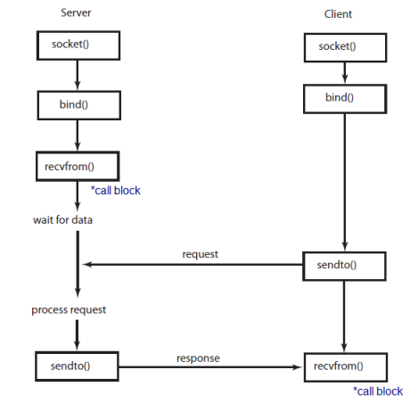
FLOW CHART

Slide 8
CONCLUSION
The server creates a 5x5 matrix for each player.
User is allowed to enter numbers from a range of numbers.
When a player gets bingo, server sends a message to the winner stating that they won and a losing message to the remaining players.

